Slide 1

Let’s Clean our bed room and living room
https://learnenglishkids.britishcouncil.org/fun-games/games/clean-green

Slide 2













Summer Holiday

Slide 3

What do you need to bring on a camping holiday?
This Photo by Unknown Author is licensed under CC BY-NC-ND

Slide 4
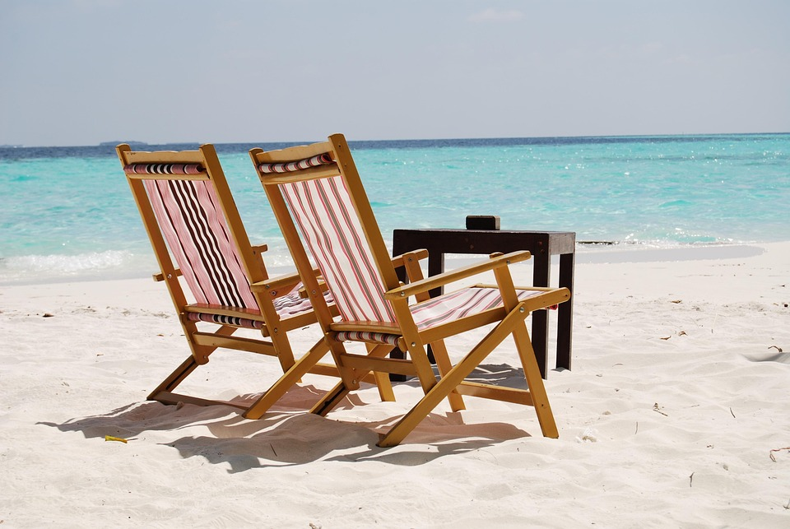
Holly’s and Harry’s holiday…..
      Where did Harry and Holly go?
      What did they take with them?
      Where did they stay?
      Why was Harry ill?
      What happened to George?

Slide 5
ate,will go,swam,went, will see,flew, bought,ran,will write,read,will finish,worked,will work
yesterday
tomorrow

Slide 6





What happened to dinosaurs ?
https://www.youtube.com/watch?v=4ygKsG59tqY

Slide 7
…

Slide 8
BINGO……..
LET’S ELICIT PLACES
1
2
3
4
5
6
7
8
9
10

